Slide 1


Unit - 3
Data Visualization using Python

Slide 2
Chapters for Discussion
Chapter - 1
Data Visualization Using Python

Slide 3

Chapter
Data Visualization using Python
3
Notes:
Dear Students, In today's session we are going to learn about Data Visualization using Python.

Slide 4
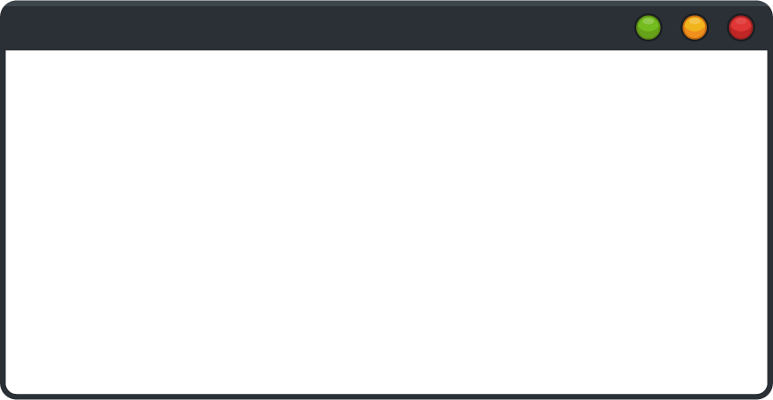

DISCLAIMER
The content is curated from online/offline resources and used for educational purpose only.

Slide 5

Learning Objectives
Use Matplotlib to create a variety of visualizations, including line, bar, pie, and scatter plots, to effectively represent data trends, comparisons, distributions, and relationships.
Customize Matplotlib plots by adding titles, labels, legends, and adjusting colors and styles to enhance clarity and visual appeal.
Analyze and interpret data insights from Matplotlib visualizations, using them to support data-driven analysis and effective communication.
GOAL
Source :
www.freepik.com/
Notes:
Learning Objectives
Use Matplotlib to create a variety of visualizations, including line, bar, pie, and scatter plots, to effectively represent data trends, comparisons, distributions, and relationships.
Customize Matplotlib plots by adding titles, labels, legends, and adjusting colors and styles to enhance clarity and visual appeal.
Analyze and interpret data insights from Matplotlib visualizations, using them to support data-driven analysis and effective communication.

Slide 6
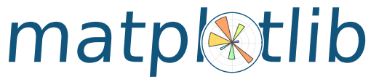
Introduction to Matplotlib
What is Matplotlib?
Matplotlib is a plotting library for creating static, animated, and interactive visualizations in Python.
Highly customizable and versatile.
Key Features:
Wide range of plots: line, bar, scatter, histogram, etc.
Control over plot appearance (colors, labels, scales).
Source :
https://www.scaler.com/topics/architecture-of-data-warehouse/
Notes:
Introduction to Matplotlib
Matplotlib is a powerful plotting library for Python that enables users to create a wide array of visualizations, including static, animated, and interactive plots. It is an essential tool for data analysis and presentation, allowing you to visualize data in an informative and aesthetically pleasing manner. Its flexibility and customization options make it a preferred choice for data scientists and analysts alike.
Highly Customizable and Versatile: Matplotlib provides a comprehensive suite of tools and options that allow users to customize every aspect of their plots, from the overall layout to individual data point styling. Whether you need simple line graphs or complex multi-dimensional visualizations, Matplotlib has the capabilities to accommodate your needs.
Key Features
Wide Range of Plots:
Matplotlib supports various types of plots to visualize data effectively, including:
Line Plots: Ideal for displaying trends over time or continuous data.
Bar Charts: Useful for comparing categorical data or showing quantities.
Scatter Plots: Effective for visualizing relationships between two variables, showcasing correlations, and identifying outliers.
Histograms: Great for showing the distribution of numerical data and understanding the frequency of values within specific ranges.
Box Plots: Helpful for summarizing the distribution of data through their quartiles, showcasing the median, and identifying potential outliers.
Control Over Plot Appearance:
Matplotlib allows for extensive customization of plot aesthetics, enabling users to enhance the visual appeal and clarity of their visualizations. Key aspects include:
Colors: Users can choose from a wide palette of colors for lines, markers, and fills, allowing for the distinction between different data series or categories.
Labels: The ability to add informative axis labels, titles, and legends improves interpretability and ensures that the audience understands the context of the visualization.
Scales: Matplotlib supports various scales (linear, logarithmic, etc.) for axes, allowing for more meaningful representations of data, especially when dealing with a wide range of values.
Annotations: Users can annotate specific points on their plots to provide additional information or highlight important trends or data points.

Slide 7
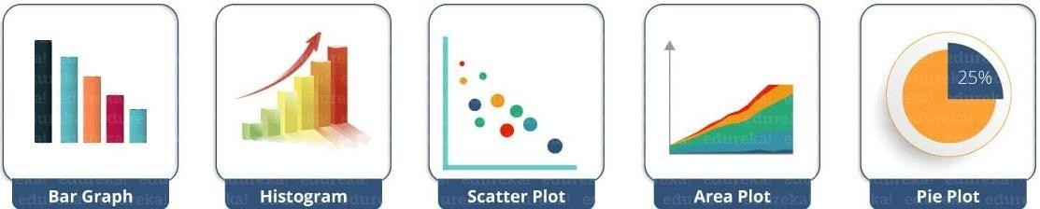
Common matplotlib.pyplot Functions
plot() – plot lines or markers to axes
scatter() – makes scatter plot for X vs Y
bar() – makes a bar graph
barh() – makes a horizontal bar graph
hist() – plot a histogram
hist2d() – make a 2D histogram plot
boxplot() – make a box and whisker plot
pie() – plot a pie graph
Source :
https://www.edureka.co/blog/how-to-become-a-python-developer/
Notes:
Commonly Used matplotlib.pyplot Functions
Matplotlib’s pyplot module provides a simple interface for creating a variety of visualizations in Python. Below are some of the most commonly used functions, along with their purposes and examples of use.
plot():
This function is used to plot lines or markers on axes. It's the most basic and versatile plotting function in Matplotlib.
Example:
import matplotlib.pyplot as plt
x = [1, 2, 3, 4]
y = [10, 20, 25, 30]
plt.plot(x, y, marker='o') # Plots a line graph with circular markers at each point
plt.title('Line Plot Example’)
plt.show()
scatter():
Creates a scatter plot, which displays values for two variables as points in a Cartesian plane.
Example:
import matplotlib.pyplot as plt
x = [1, 2, 3, 4]
y = [10, 20, 25, 30]
plt.scatter(x, y, color='blue') # Plots a scatter plot of x vs y
plt.title('Scatter Plot Example’)
plt.xlabel('X-axis’)
plt.ylabel('Y-axis’)
plt.show()
bar():
Generates a bar graph to compare different categories or groups of data.
Example:
import matplotlib.pyplot as plt
categories = ['A', 'B', 'C’]
values = [3, 7, 5]
plt.bar(categories, values, color='orange') # Creates a vertical bar graph
plt.title('Bar Graph Example’)
plt.show()
barh():
Similar to bar(), but creates a horizontal bar graph, which can be useful for displaying long category names.
Example:
import matplotlib.pyplot as plt
categories = ['A', 'B', 'C’]
values = [3, 7, 5]
plt.barh(categories, values, color='green') # Creates a horizontal bar graph
plt.title('Horizontal Bar Graph Example’)
plt.show()
hist():
Plots a histogram to visualize the distribution of a dataset by grouping data into bins.
Example:
import matplotlib.pyplot as plt
data = [1, 2, 2, 3, 3, 3, 4, 4, 5]
plt.hist(data, bins=5, color='purple', alpha=0.7) # Creates a histogram with 5 bins
plt.title('Histogram Example’)
plt.show()
hist2d():
Creates a 2D histogram plot, which is useful for visualizing the joint distribution of two variables.
Example:
import numpy as np
x = np.random.randn(1000)
y = np.random.randn(1000)
plt.hist2d(x, y, bins=30, cmap='Blues') # Creates a 2D histogram
plt.title('2D Histogram Example’)
plt.colorbar() # Adds a color bar to indicate frequency
plt.show()
boxplot():
Generates a box and whisker plot, which summarizes the distribution of data based on a five-number summary: minimum, first quartile, median, third quartile, and maximum.
Example:
import numpy as np
data = [np.random.normal(0, std, 100) for std in range(1, 4)]
plt.boxplot(data) # Creates a box plot for multiple datasets
plt.title('Box Plot Example’)
plt.xticks([1, 2, 3], ['STD 1', 'STD 2', 'STD 3’])
plt.show()
pie():
Plots a pie chart to display the proportions of a whole for different categories.
Example:
import numpy as np
sizes = [15, 30, 45, 10] # Proportions of each category
labels = ['Category A', 'Category B', 'Category C', 'Category D’]
plt.pie(sizes, labels=labels, autopct='%1.1f%%', startangle=140) # Creates a pie chart
plt.title('Pie Chart Example’)
plt.axis('equal') # Equal aspect ratio ensures that pie chart is circular
plt.show()

Slide 8
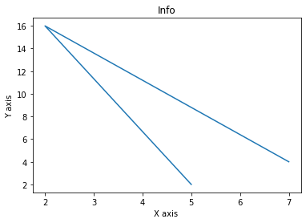
Example of Matplotlib Plot
from matplotlib import pyplot as plt
x = [5,2,7]
y = [2,16,4]
plt.plot(x,y)
plt.title('Info')
plt.ylabel('Y axis') plt.xlabel('X axis')
plt.show()
Notes:
This code creates a simple line plot using the matplotlib library in Python.
Importing Matplotlib: matplotlib.pyplot is imported as plt, allowing access to plotting functions.
Defining Data: The lists x and y define the data points for the x-axis and y-axis, respectively. In this case, x = [5, 2, 7] and y = [2, 16, 4].
Plotting the Data: plt.plot(x, y) generates a line plot where points in x are paired with points in y.
Adding Titles and Labels:
plt.title('Info') sets the title of the plot to "Info".
plt.ylabel('Y axis') labels the y-axis as "Y axis".
plt.xlabel('X axis') labels the x-axis as "X axis".
Displaying the Plot: plt.show() renders the plot on the screen.
This code results in a simple line plot with labeled axes and a title.

Slide 9
Matplotlib Applications
Data Exploration:
Visualizing data distributions and relationships.
Publication Quality Plots:
Creating detailed and customizable plots suitable for publications.
Integration:
Works well with NumPy and Pandas for data visualization.
Notes:
Applications of Matplotlib
Matplotlib is widely used across data science, research, and industry for creating clear and informative visualizations. It offers versatility, making it an essential tool for understanding data, producing publication-ready graphics, and seamlessly integrating with other data science libraries.
Data Exploration:
Purpose: Visualizing data distributions, patterns, and relationships to gain insights during data exploration.
Applications:
Exploratory Data Analysis (EDA): Histograms, scatter plots, and box plots allow users to understand data distributions, identify outliers, and analyze correlations between variables.
Pattern Identification: Line and bar graphs make it easy to spot trends over time or across categories, helping analysts detect seasonality, cyclic patterns, or anomalies in datasets.
Example Use Case: A data scientist might use Matplotlib to quickly generate histograms of different variables in a dataset to understand their spread, or use scatter plots to examine relationships between features.
Publication Quality Plots:
Purpose: Creating detailed and customizable plots suitable for professional and academic publications.
Applications:
High-Resolution Visuals: Matplotlib supports high-quality outputs in various formats (PNG, PDF, SVG), making it easy to produce clear graphics for reports, papers, or presentations.
Customization Options: With Matplotlib, users can adjust color schemes, font sizes, line thickness, and add complex annotations, making it possible to meet specific publication or presentation standards.
Consistency Across Graphics: Matplotlib’s flexibility allows users to create consistent themes across multiple visualizations, which is valuable in creating cohesive figures for publications.
Example Use Case: A researcher preparing a paper might use Matplotlib to generate a line chart with customized colors and annotations to clearly explain findings or trends.
Integration with Other Libraries:
Purpose: Matplotlib works seamlessly with NumPy and Pandas, making it easy to visualize data directly from these data-processing libraries.
Applications:
Data Analysis Pipelines: By integrating with Pandas and NumPy, users can plot data directly from DataFrames or arrays, streamlining the process of transitioning from data processing to data visualization.
Combined Analysis: Users can perform calculations and transformations with Pandas and NumPy, then use Matplotlib for immediate visualization, making iterative analysis and visualization much faster.
Complementary Libraries: Matplotlib’s foundational role allows it to complement libraries like Seaborn (for advanced statistical visualizations) and Plotly (for interactive visualizations).
Example Use Case: An analyst can perform data cleaning and calculations with Pandas, then use Matplotlib to generate bar and line charts from the cleaned data for quick interpretation and insights.

Slide 10

Lab Activity
Hands On
Lab 1
Visualization Using Matplotlib.

Slide 11

Conclusion
This overview provides a structured approach to learning
Source :
www.freepik.com/

Slide 12
References
https://matplotlib.org/stable/tutorials/introductory/pyplot.html

Slide 13


Let’s Start

Slide 14


Quiz
What is the primary purpose of the Matplotlib library in Python?
A) To manage databases
B) To create a wide array of visualizations
C) To perform statistical analysis
D) To handle file input and output
Answer: B
To create a wide array of visualizations

Slide 15
Quiz
2. Which of the following types of plots is NOT supported by Matplotlib?
A) Line Plots
B) Bar Charts
C) Heat Maps
D) Scatter Plots
Answer: C
Heat Maps

Slide 16
Quiz
3. How does Matplotlib allow users to enhance the visual appeal of their plots?
A) By limiting color options
B) By providing pre-defined styles only
C) Through extensive customization options for colors, labels, and scales
D) By restricting the type of visualizations available
Answer: C
Through extensive customization options for colors, labels, and scales

Slide 17
Quiz
4. Which function in Matplotlib is used to create a scatter plot?
A) plot()
B) bar()
C) scatter()
D) hist()
Answer: C
scatter()

Slide 18
Quiz
5. Which of the following types of plots can you create using Matplotlib?
A) Line Plots
B) Bar Charts
C) Scatter Plots
D) All of the above
Answer: D
All of the above

Slide 19
Thank You
Notes:
Thank You !!

